Slide 1
ECE595: Image Processing
Thumbprint Matching Experiment
Juan Silva Christian Rodas
December 4, 2019

Slide 2
Background
Applying morphological concepts to preprocess images for experiments.
Image matching using Cross Correlation, a type of descriptor for characterizing co-occurrence matrices.
Correlation is a convolution-type calculation that returns a matrix of peak values.
Notes:
What we hope to accomplish with this experiment is to:

Slide 3
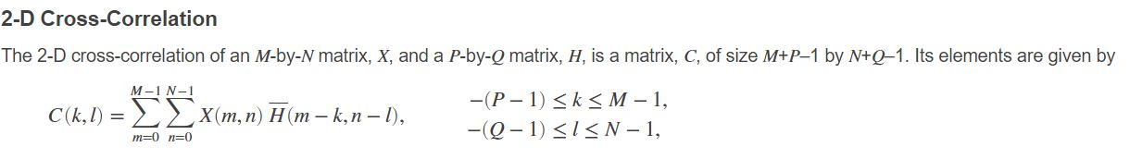
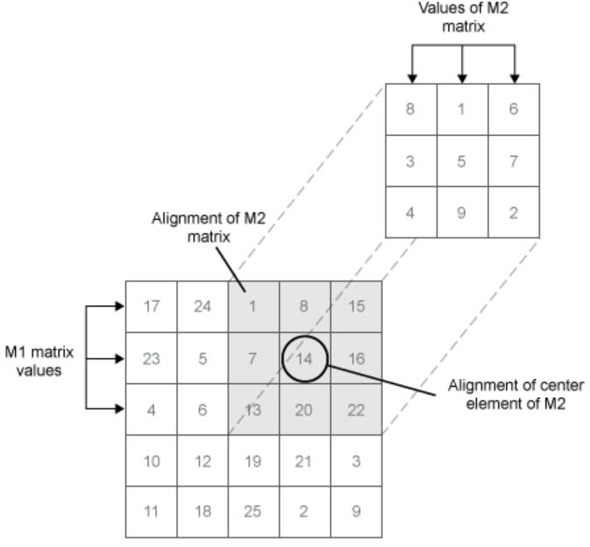
Cross Correlation of Two Images

Slide 4
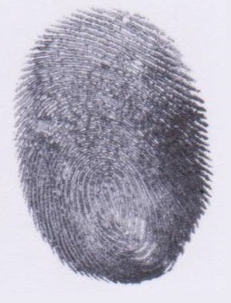
Experiment Procedure
Obtain two scanned thumbprint images for comparison.
Prepare the images via formatting and image processing. - The images must be the same size and in black & white.
Three cases are applied for correlation: - Two identical images (autocorrelation). - Two different images (cross-correlation). - Two similar images (cross-correlation).
Interpret results.
260x340 Grayscale.
Notes:
Inputs are two thumprints

Slide 5
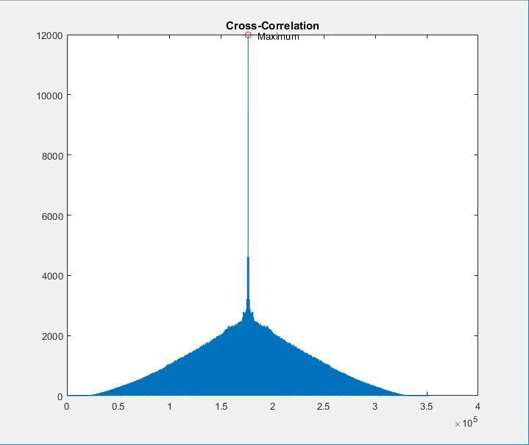
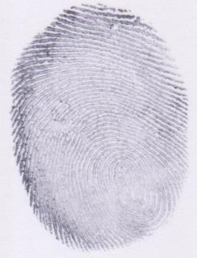
Case 1 : Two Identical Images (1 to 1)
Auto-Correlation Expected Significant spike to indicate positive correlation. Serves as a control for this experiment.
Notes:
Image processing done was converting to Grayscale, binarizing it, and apply thinning to condense the image. Cross-correlation is applied and graphed to visualize it’s relationship

Slide 6
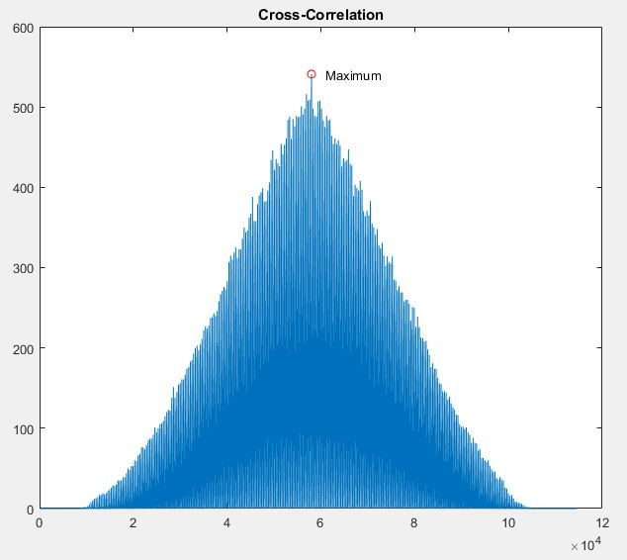
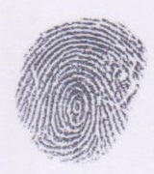
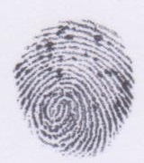
Case 2 : Two Different Images
Cross-Correlation Expected Lowest peaks because fingerprints are different. Negative correlation.

Slide 7
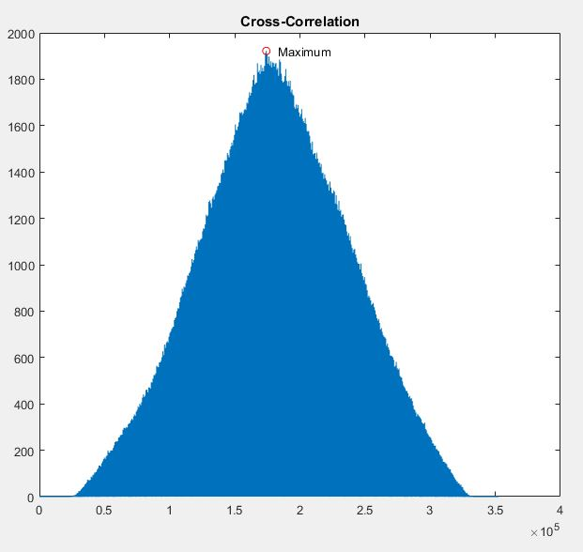
Case 2 : Two Similar Images (Not 1 to 1)
Cross-Correlation Expected Larger peaks because fingerprints are somewhat similar. Positive correlation.

Slide 8
Observations and Results
Results of experiment provide insight as to how cross correlation can be used to model image matching.
One observation that was recognized was the result in Case 3 showing that two possibly similar images will generate a higher correlation.
Quantizing this correlation such as using a correlation coefficient or p-values would be the optimal approach in determining correlation accurately.

